Slide 1
Storefront

Slide 2
Storefront | Producer or Agency Experience

Slide 3
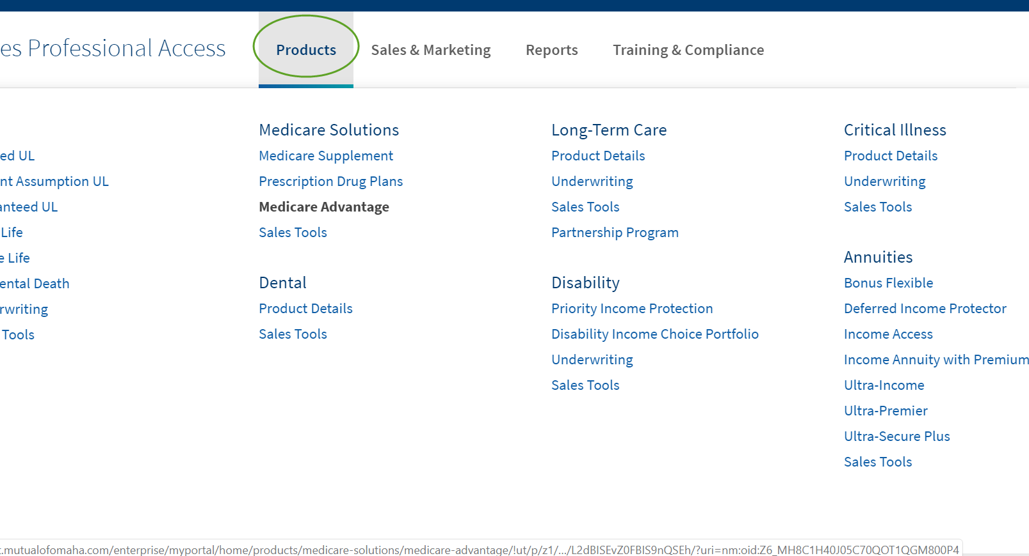
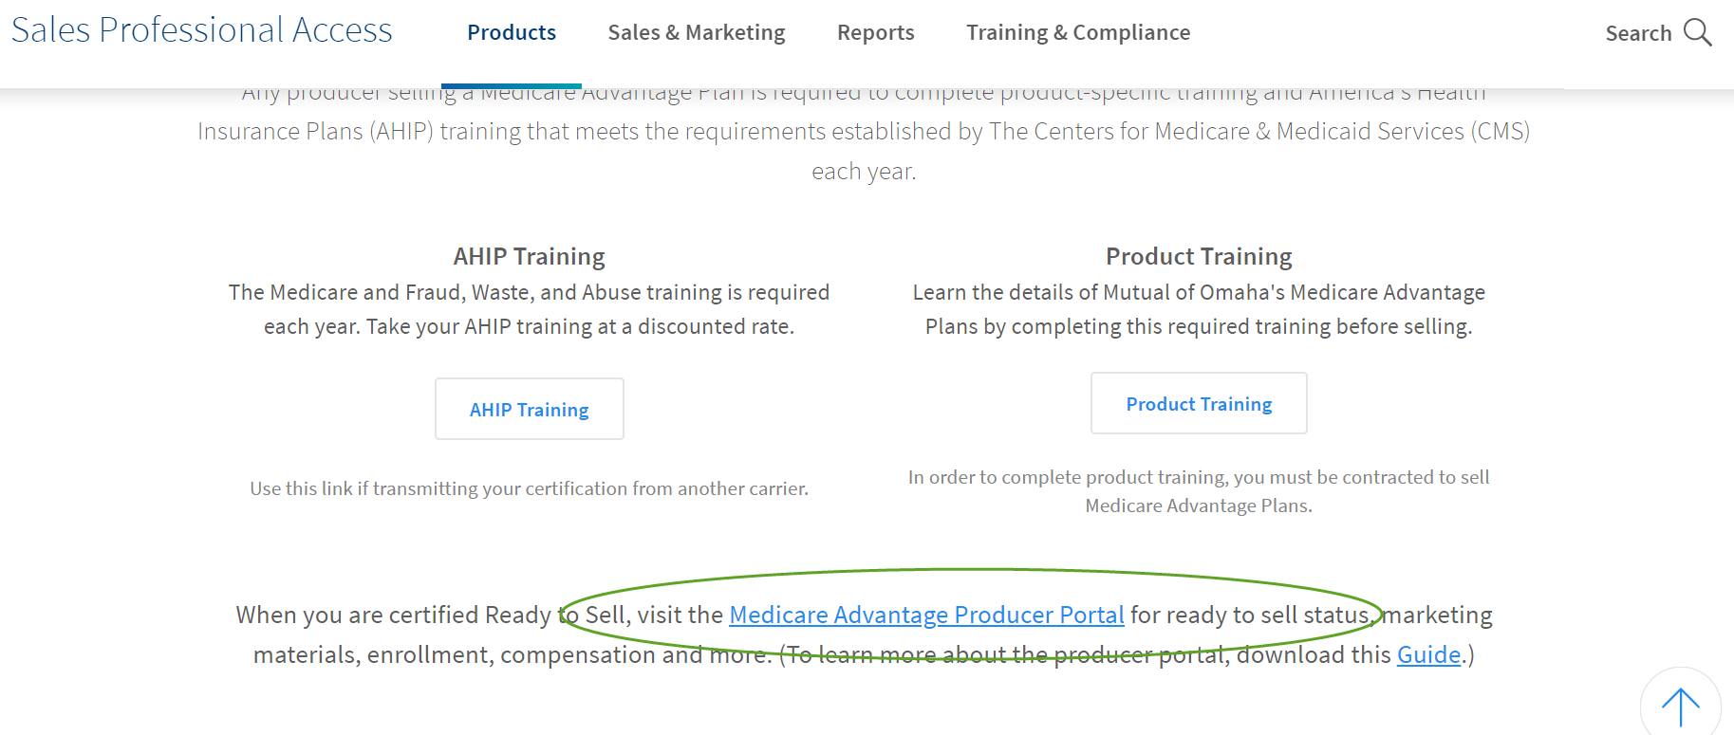
Log in to Sales Professional Access
Click on Products
Medicare Advantage
Click on Medicare Advantage Producer Portal

Slide 4
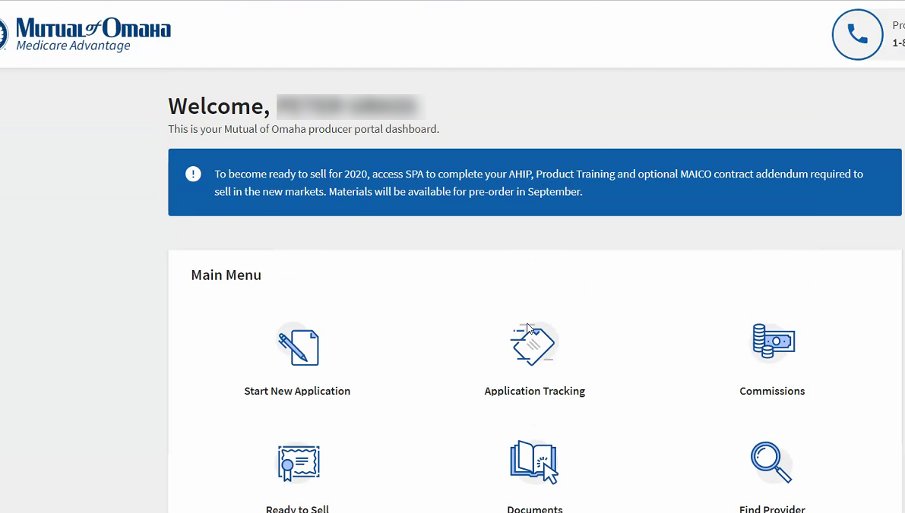
Here you can click on Ready to Sell (RTS) to see your current status.

Slide 5
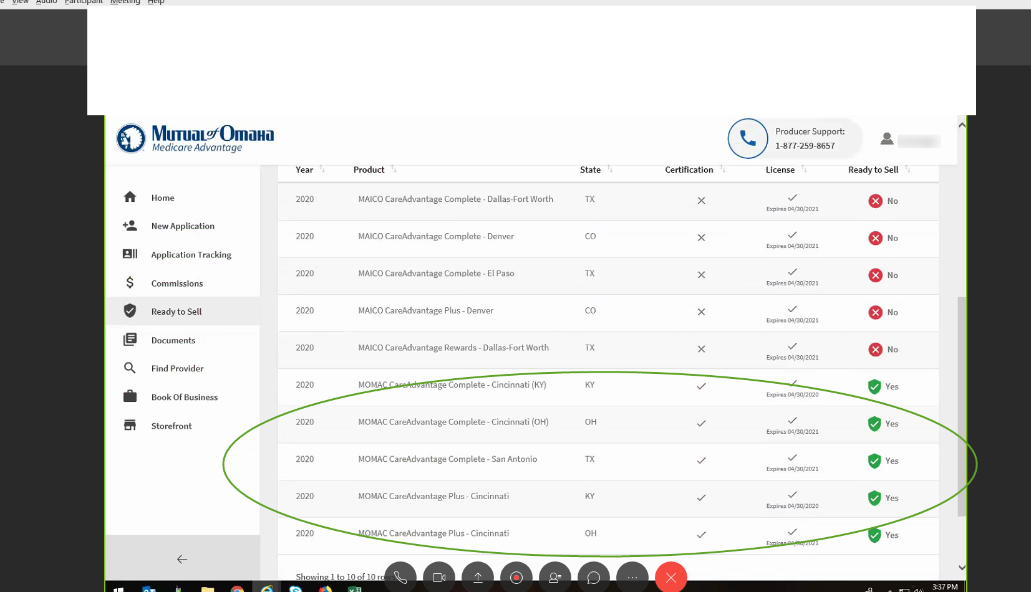
This screen allows you to see which markets you are RTS in. There is a tab for both 2019 and 2020.
Also by clicking the “Storefront” link, you can go directly to order materials.

Slide 6
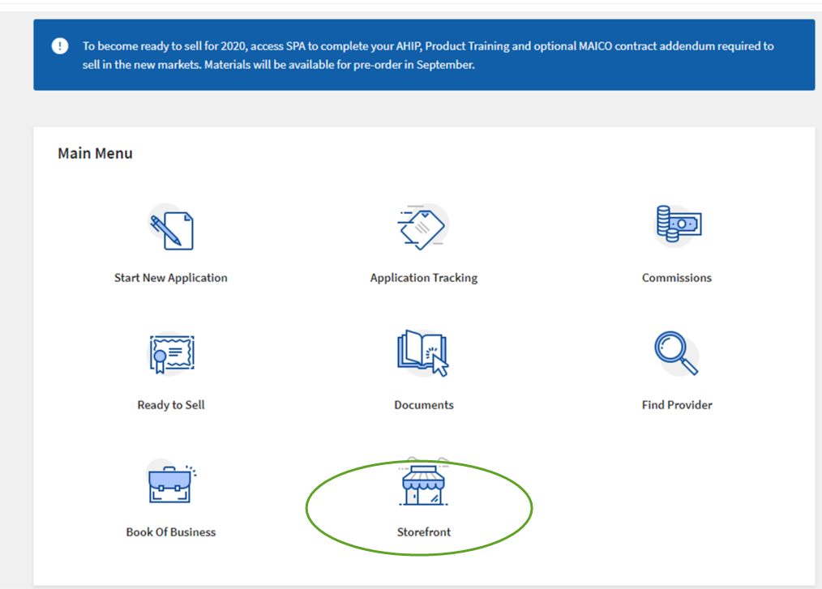
To access the Storefront, click the icon on the portal home page.

Slide 7
Here you can select your market and begin the process to get your materials.
Once market is selected, material for that area will populate. Some items in each category are:
Enrollment Materials – Enrollment kits, downloadable apps
Producer Marketing – Postcards, posters, sales presentations
Advisor Producer Marketing – Specific postcards & posters for Mutual of Omaha Advisors

Slide 8
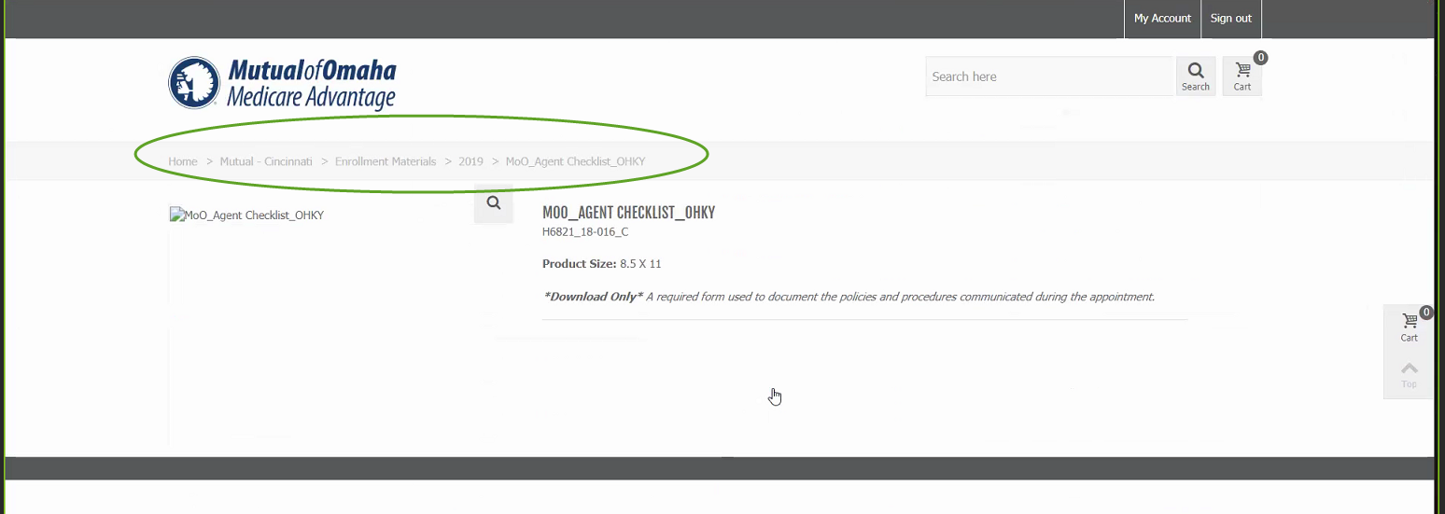
Once you have chosen the market you will be navigated to a screen to begin order materials.

Slide 9
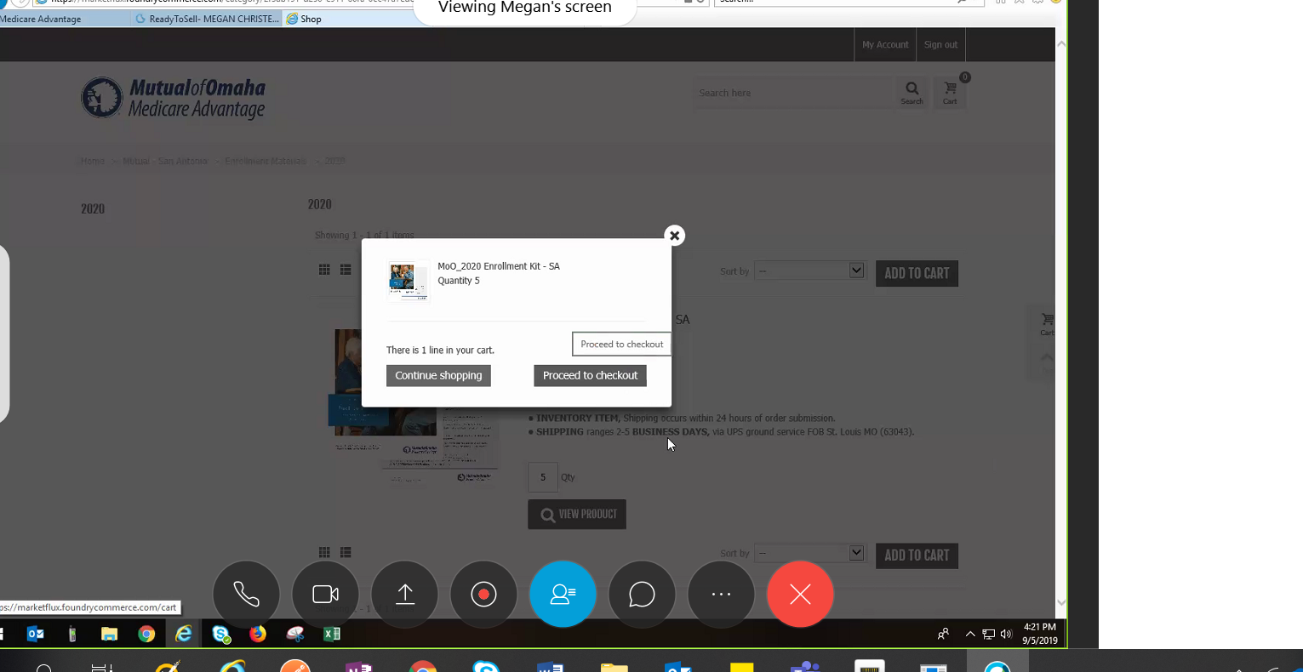
Insert the product quantity, click “Add to Cart”, and then you can proceed to checkout or continue shopping.

Slide 10
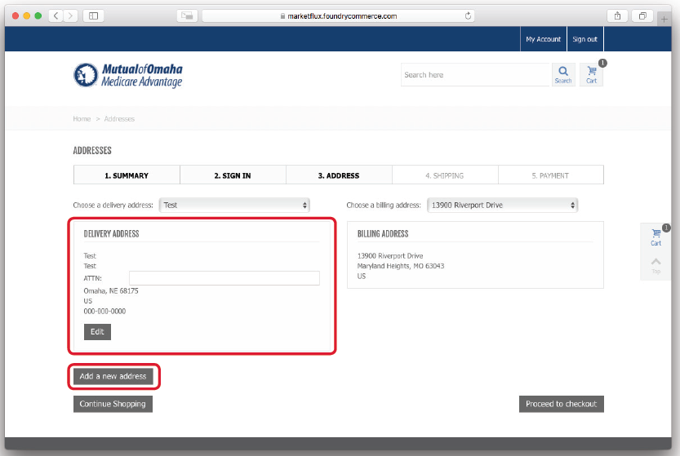
Follow the steps to complete your order.
Once your address has been provided through the checkout process, it will be stored for future use.

Slide 11
You will get a confirmation page that shows your order has been submitted.

Slide 12
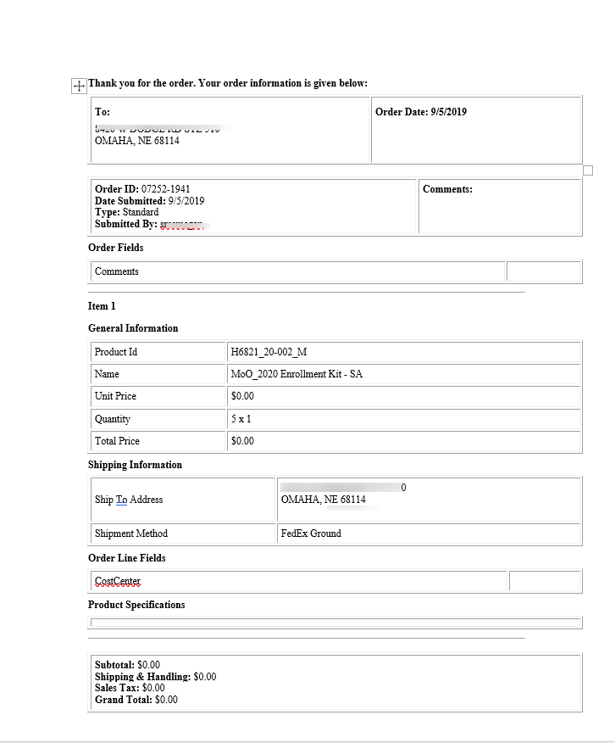
Once ordered, you will receive a confirmation email which provides you an invoice of the order. .

Slide 13
To determine your order status you can navigate to your “My Account” and see your order status and history.

Slide 14
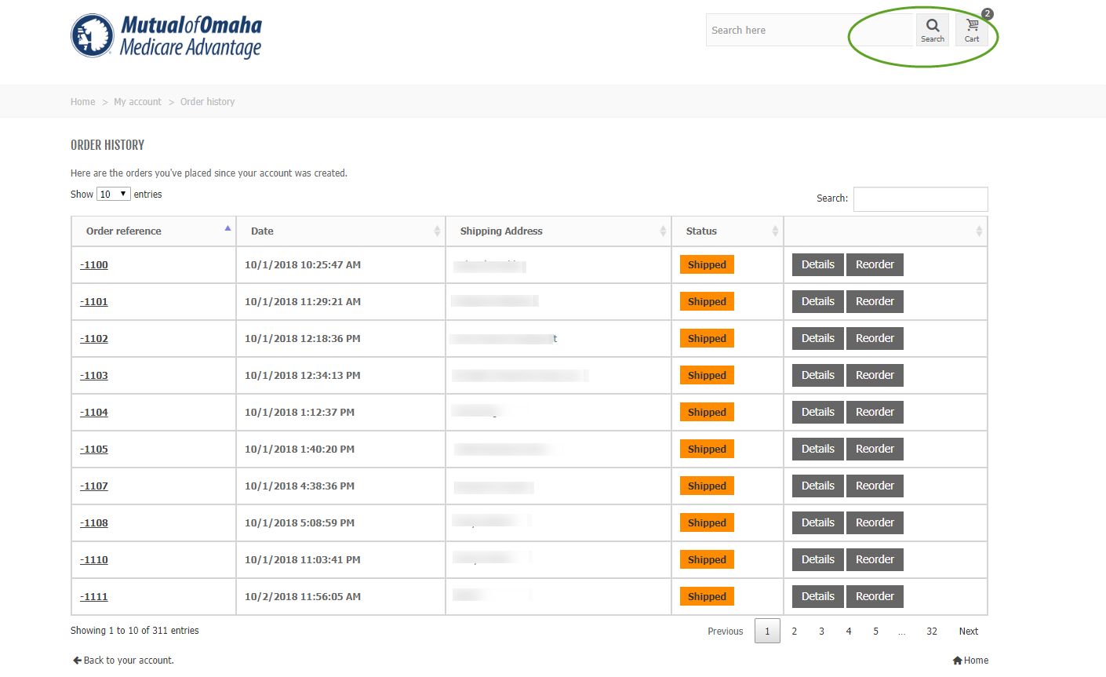
Order history is then displayed.

Slide 15
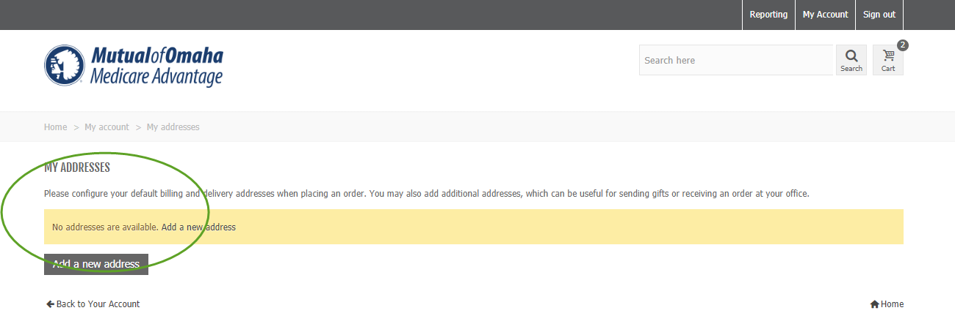
Here you can configure your billing and delivery address.

